Slide 1

Chapter 3
Data Description

Slide 2


Slide 3
Chapter 3 Overview
Introduction
3-1 Measures of Central Tendency
3-2 Measures of Variation
3-3 Measures of Position
3-4 Exploratory Data Analysis

Slide 4
Chapter 3 Objectives
Summarize data using measures of central tendency.
Describe data using measures of variation.
Identify the position of a data value in a data set.
Use boxplots and five-number summaries to discover various aspects of data.

Slide 5
Introduction
Traditional Statistics
Average
Variation
Position

Slide 6
分析資料—以統計測量數呈現
中心位置的衡量
等分位置的衡量
分散度的衡量
盒鬚圖分析法
平均數
四分位數
全 距
平均絕對離差
中位數
十分位數
變異數
眾 數
百分位數
標準差
四分位差
林惠玲 陳正倉著 雙葉書廊發行 2008

Slide 7
Section 3.1
Measures of
Central Tendency

Slide 8
Parameter & Statistics
Parameter
A parameter is a characteristic or measure obtained by using all the data values for a specific population.
As long as the population does not change, the value of the parameter will not change.
Statistics
A statistic is a characteristic or measure obtained by using the data values from a sample.
The value of the statistic will depend on which sample is selected.

Slide 9
Measures of Central Tendency
What Do We Mean By Average?
Mean
Median
Mode
Midrange
Weighted Mean

Slide 10
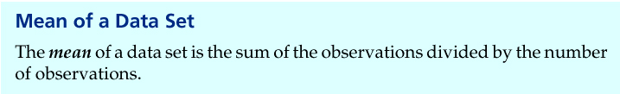
Definition: mean
Mean of data set
Population data
Sample data
Population mean
Sample mean
Notes:
Change to page 92

Slide 11
Mean
The mean is the quotient of the sum of the values and the total number of values.
The symbol is used for sample mean.
Greek letter μ (mu), is use for population mean.

Slide 12
Example 1: Days Off per Year
The data represent the number of days off per year for a sample of individuals selected from nine different countries. Find the mean.
20, 26, 40, 36, 23, 42, 35, 24, 30
The mean number of days off is 30.7 years.

Slide 13
Rounding Rule: Mean
The mean should be rounded to one more decimal place than occurs in the raw data.
The mean, in most cases, is not an actual data value.

Slide 14
Mean for Grouped Data
The mean for grouped data is calculated by multiplying the frequencies and midpoints of the classes.

Slide 15
Example 2: Miles Run per Week
Below is a frequency distribution of miles run per week. Find the mean.
Class Boundaries | Frequency
5.5 - 10.5 10.5 - 15.5 15.5 - 20.5 20.5 - 25.5 25.5 - 30.5 30.5 - 35.5 35.5 - 40.5
1
2
3
5
4
3
2
Σf = 20

Slide 16
Example 2: Miles Run
Class | Frequency, f | Midpoint, X_{m}
5.5 - 10.5 10.5 - 15.5 15.5 - 20.5 20.5 - 25.5 25.5 - 30.5 30.5 - 35.5 35.5 - 40.5
f ·X_{m}
1
2
3
5
4
3
2
8
13
18
23
28
33
38
8
26
54
115
112
99
76
Σf = 20
Σ f ·X_{m} = 490

Slide 17
Median
The median is the midpoint of the data array. The symbol for the median is MD.
The median will be one of the data values if there is an odd number of values.
The median will be the average of two data values if there is an even number of values.

Slide 18
Example 3: Hotel Rooms
The number of rooms in the seven hotels in downtown Pittsburgh is
713, 300, 618, 595, 311, 401, and 292.
Find the median.
Sort in ascending order.
292, 300, 311, 401, 596, 618, 713
Select the middle value.
MD = 401
The median is 401 rooms.

Slide 19
Example 4:Tornadoes in the U.S.
The number of tornadoes that have occurred in the United States over an 8-year period follows. Find the median.
684, 764, 656, 702, 856, 1133, 1132, 1303
Find the average of the two middle values.
656, 684, 702, 764, 856, 1132, 1133, 1303
The median number of tornadoes is 810.

Slide 20
Mode
The mode is the value that occurs most often in a data set.
It is sometimes said to be the most typical case.
There may be no mode, one mode (unimodal), two modes (bimodal), or many modes (multimodal).

Slide 21
Example 3-6: NFL Signing Bonuses
Find the mode of the signing bonuses of eight NFL players for a specific year. The bonuses in millions of dollars are
18.0, 14.0, 34.5, 10, 11.3, 10, 12.4, 10
You may find it easier to sort first.
10, 10, 10, 11.3, 12.4, 14.0, 18.0, 34.5
Select the value that occurs the most.
The mode is 10 million dollars.

Slide 22
Example: Coal Employees in PA
Find the mode for the number of coal employees per county for 10 selected counties in southwestern Pennsylvania.
110, 731, 1031, 84, 20, 118, 1162, 1977, 103, 752
No value occurs more than once.
There is no mode.

Slide 23
Example 3-7: Licensed Nuclear Reactors
The data show the number of licensed nuclear reactors in the United States for a recent 15-year period. Find the mode.
104 104 104 104 104 107 109 109 109 110
109 111 112 111 109
104 and 109 both occur the most. The data set is said to be bimodal.
104 104 104 104 104 107 109 109 109 110
109 111 112 111 109
The modes are 104 and 109.

Slide 24
Example: Miles Run per Week
Find the modal class for the frequency distribution of miles that 20 runners ran in one week.
Class | Frequency
5.5 – 10.5 | 1
10.5 – 15.5 | 2
15.5 – 20.5 | 3
20.5 – 25.5 | 5
25.5 – 30.5 | 4
30.5 – 35.5 | 3
35.5 – 40.5 | 2
The modal class is
20.5 – 25.5.
The mode, the midpoint
of the modal class, is
23 miles per week.

Slide 25
Midrange
The midrange is the average of the lowest and highest values in a data set.

Slide 26
Example 3-12: Bank Failure
The number of the bank failures for a recent five-year period is shown. Find the midrange.
3, 30, 148, 157, 71
The midrange is 80.

Slide 27
Weighted Mean
Find the weighted mean of a variable by multiplying each value by its corresponding weight and dividing the sum of the products by the sum of the weights.

Slide 28
Example 3-14: Grade Point Average
A student received the following grades. Find the corresponding GPA.
Course | Credits, w | Grade, X
Statistics | 3 | A (4 points)
Calculus | 3 | C (2 points)
Biology | 4 | B (3 points)
Physical Education | 2 | D (1 point)
The grade point average is 2.7.

Slide 29
Properties of the Mean
Uses all data values.
Varies less than the median or mode
Used in computing other statistics, such as the variance
Unique, usually not one of the data values
Cannot be used with open-ended classes
Affected by extremely high or low values, called outliers

Slide 30
Properties of the Median
Gives the midpoint
Used when it is necessary to find out whether the data values fall into the upper half or lower half of the distribution.
Can be used for an open-ended distribution.
Affected less than the mean by extremely high or extremely low values.

Slide 31
Properties of the Mode
Used when the most typical case is desired
Easiest average to compute
Can be used with nominal data
Not always unique or may not exist

Slide 32
Properties of the Midrange
Easy to compute.
Gives the midpoint.
Affected by extremely high or low values in a data set

Slide 33
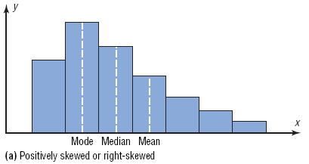
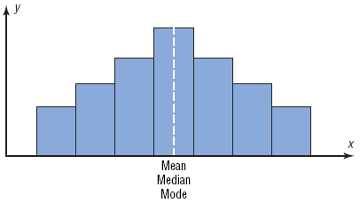
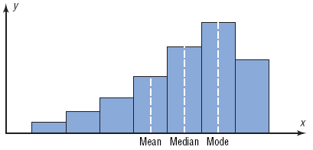
Distributions

Slide 34
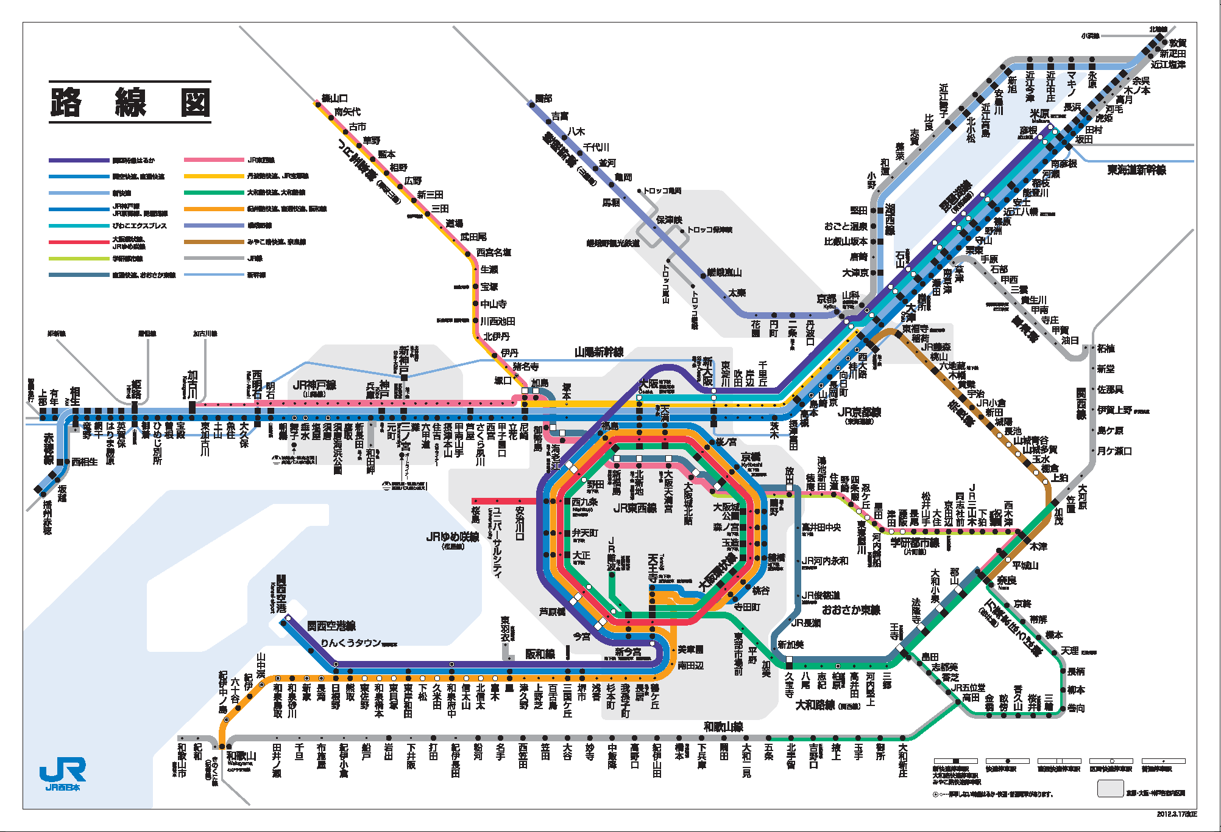

Slide 35
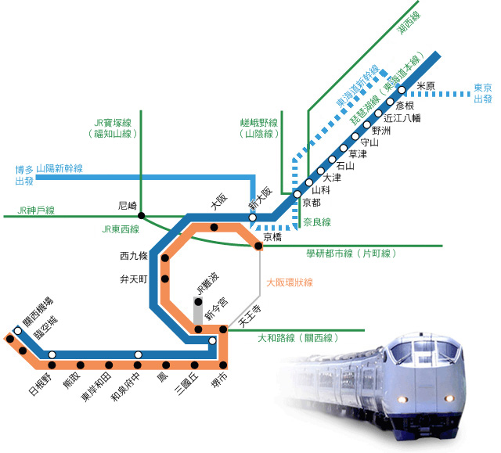

Slide 36
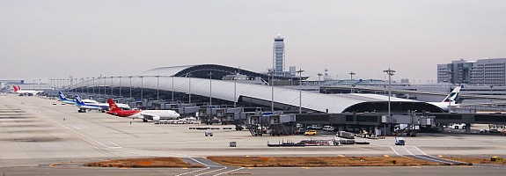

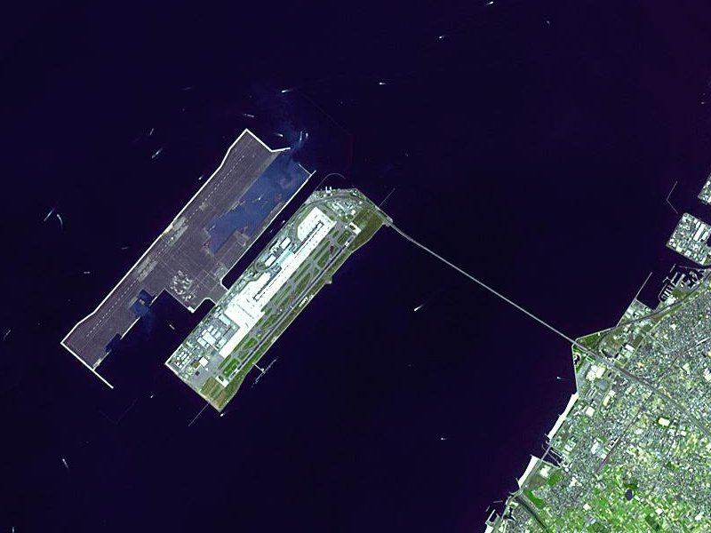


Slide 37
Section 3-2
Measures of Variation

Slide 38
Measures of Variation
How Can We Measure Variability?
Range
Variance
Standard Deviation
Coefficient of Variation
Chebyshev’s Theorem
Empirical Rule (Normal)

Slide 39


Slide 40
Measures of Variation: Range
The range is the difference between the highest and lowest values in a data set.

Slide 41
Example 3-15/16: Outdoor Paint
Two experimental brands of outdoor paint are tested to see how long each will last before fading. Six cans of each brand constitute a small population. The results (in months) are shown. Find the mean and range of each group.
Brand A | Brand B
10 | 35
60 | 45
50 | 30
30 | 35
40 | 40
20 | 25

Slide 42
Example 3-18: Outdoor Paint
Brand A | Brand B
10 | 35
60 | 45
50 | 30
30 | 35
40 | 40
20 | 25
The average for both brands is the same, but the range
for Brand A is much greater than the range for Brand B.
Which brand would you buy?

Slide 43
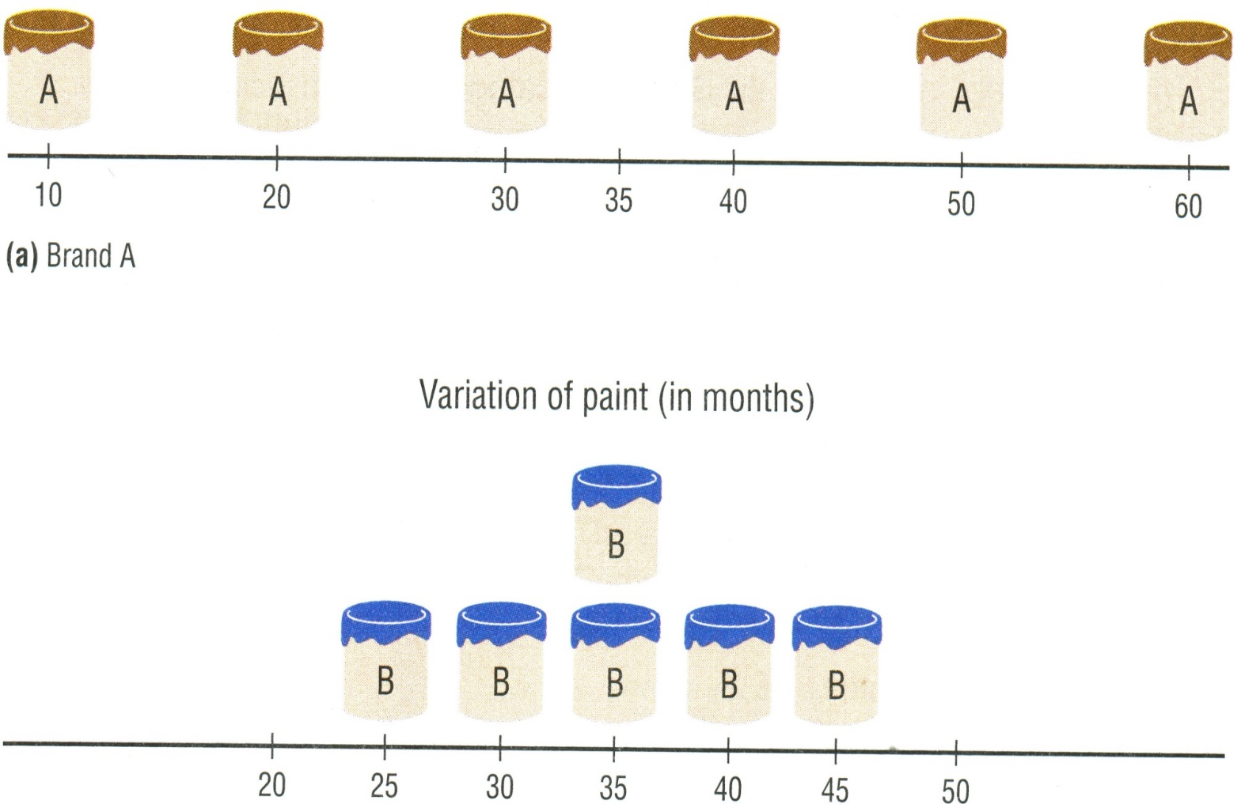

Brand A | 10 | 60 | 50 | 30 | 40 | 20
Brand B | 35 | 45 | 30 | 35 | 40 | 25

Slide 44
Measures of Variation: Mean Deviation
Population:
Mean:

Slide 45

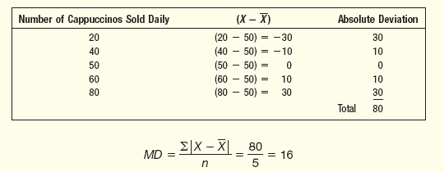
EXAMPLE – Mean Deviation
The number of cappuccinos sold at the Starbucks location in the Taoyuan Airport between 4 and 7 p.m. for a sample of 5 days last year were 20, 40, 50, 60, and 80. Determine the mean deviation for the number of cappuccinos sold.
Source: Douglas

Slide 46
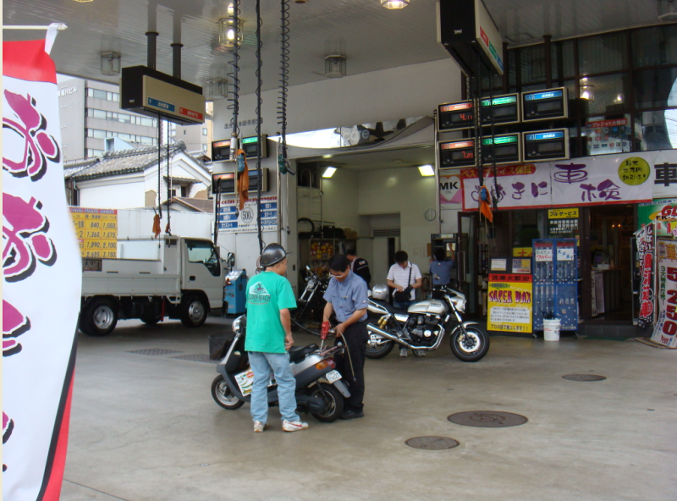

Slide 47
Variance & Standard Deviation
The variance is the average of the squares of the distance each value is from the mean.
The standard deviation is the square root of the variance.
The standard deviation is a measure of how spread out your data are.

Slide 48
Uses of the Variance and Standard Deviation
To determine the spread of the data.
To determine the consistency of a variable.
To determine the number of data values that fall within a specified interval in a distribution (Chebyshev’s Theorem).
Used in inferential statistics.

Slide 49
Variance & Standard Deviation (Population Theoretical Model)
The population variance is
The population standard deviation is

Slide 50
Example 3-18: Outdoor Paint
Find the variance and standard deviation for the data set for Brand A paint. 10, 60, 50, 30, 40, 20
Months, X | µ | X - µ | (X - µ)²
10 60 50 30 40 20
N
35
35
35
35
35
35
-25
25
15
-5
5
-15
625
625
225
25
25
225
1750

Slide 51
Example 3-19: Outdoor Paint
Find the variance and standard deviation for the data set for Brand B paint. 35, 45, 30, 35, 40, 25
Months, X | µ | X - µ | (X - µ)²
35 45 30 35 40 25
N
35
35
35
35
35
35

Slide 52
Variance & Standard Deviation (Sample Theoretical Model)
The sample variance is
The sample standard deviation is

Slide 53
Example: European Auto Sales
Find the variance and standard deviation for the amount of European auto sales for a sample of 6 years. The data are in millions of dollars.
11.2, 11.9, 12.0, 12.8, 13.4, 14.3
Mean=12.6
=[(11.2-12.6)²+(11.9-12.6)²+…]/(6-1)²
=1.276

Slide 54
Example: European Auto Sales
Find the variance and standard deviation for the amount of European auto sales for a sample of 6 years. The data are in millions of dollars.
11.2, 11.9, 12.0, 12.8, 13.4, 14.3
X | X ²
11.2 11.9 12.9 12.8 13.4 14.3
125.44
141.61
166.41
163.84
179.56
204.49
75.6
958.94

Slide 55
variation of data set
Population data
Sample data
Population variation
Sample variation
Variance:
Standard
Deviation:

Slide 56
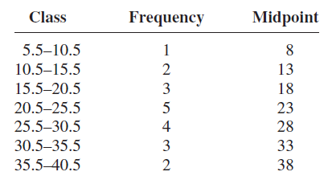
Variance and Standard Deviation for Grouped Data
Example 3.24

Slide 57
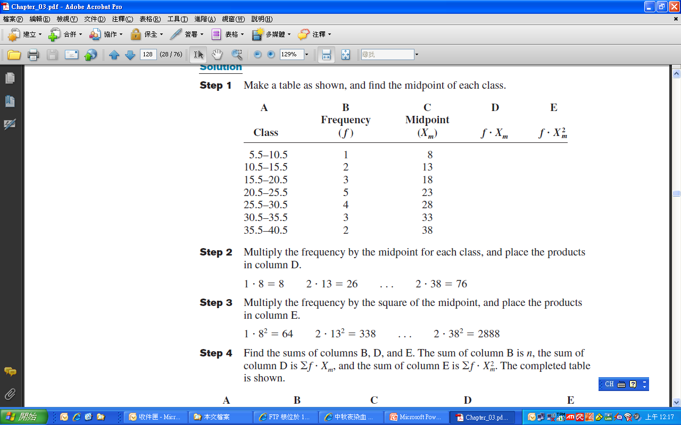

Slide 58
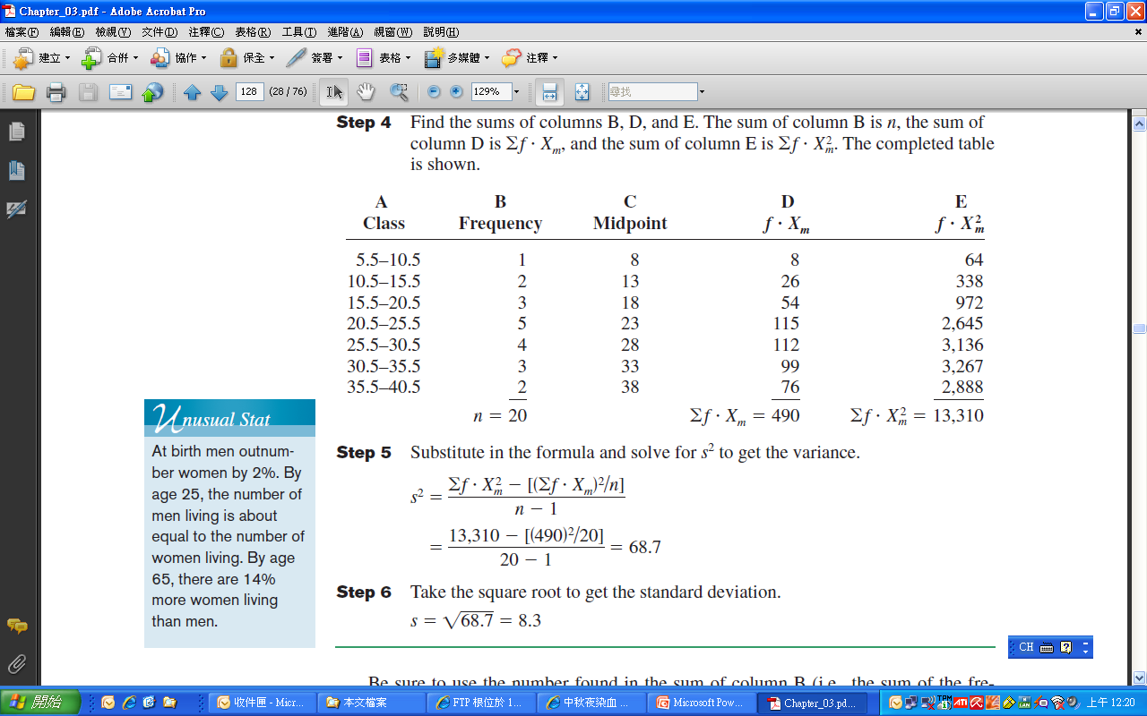
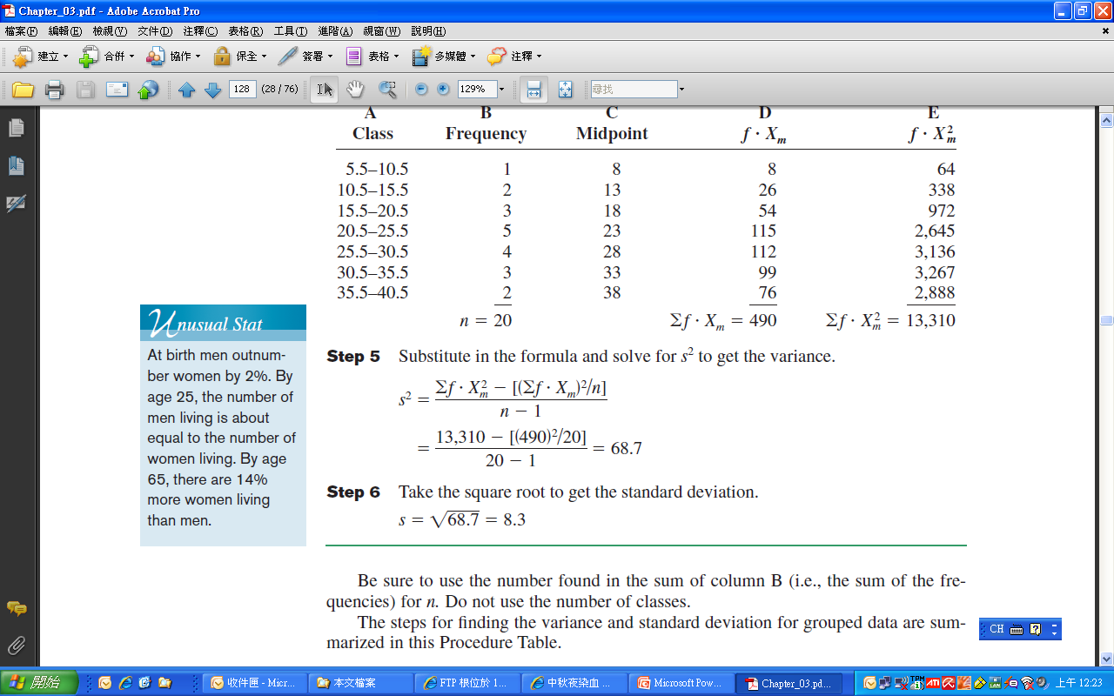

Slide 59
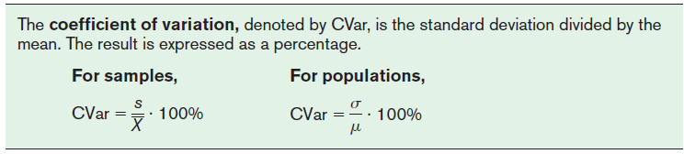
Coefficient of Variation
Use CVar to compare standard deviations when the units are different.

Slide 60
Example 3-23: Sales of Automobiles
The mean of the number of sales of cars over a 3-month period is 87, and the standard deviation is 5. The mean of the commissions is $5225, and the standard deviation is $773. Compare the variations of the two.
Commissions are more variable than sales.

Slide 61
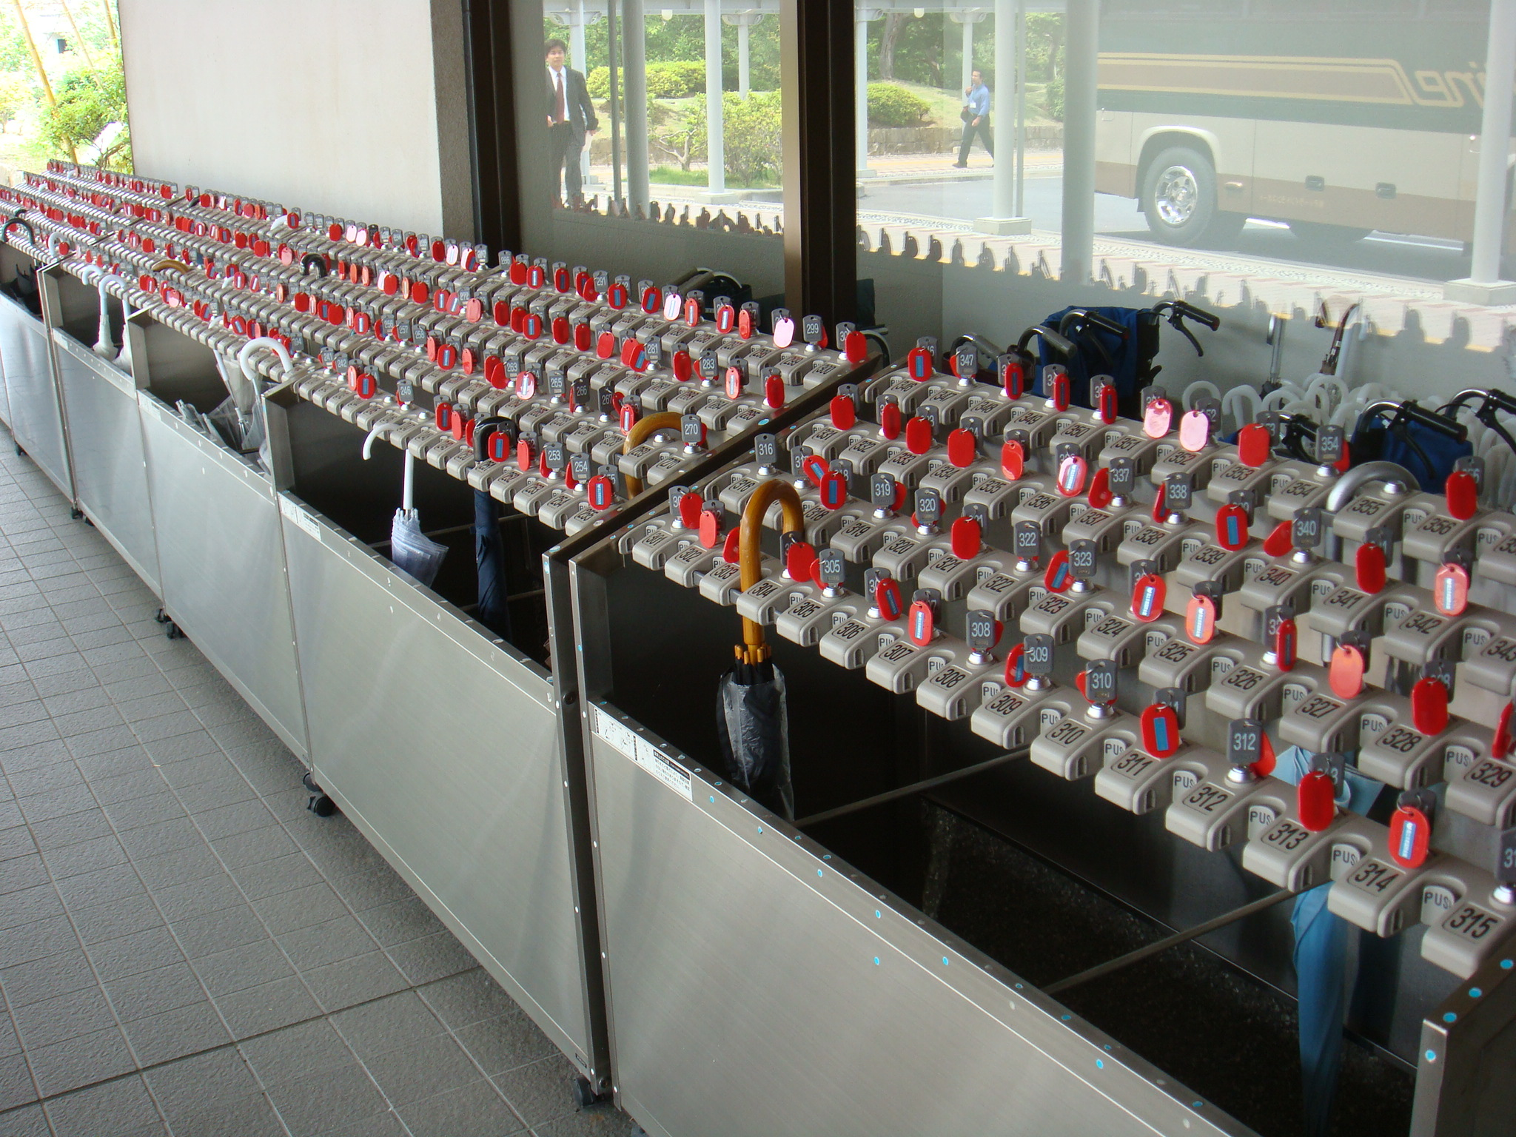

Slide 62
Chebyshev’s Theorem
Known: Mean & standard deviation
Distribution unknown
Mean

Slide 63
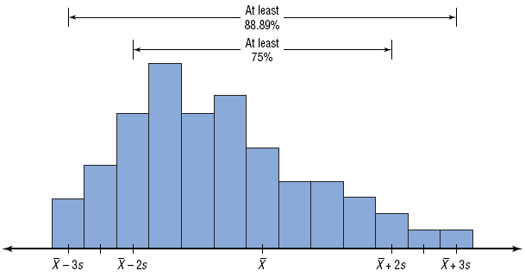
Chebyshev’s Theorem

Slide 64
Chebyshev’s Theorem
The proportion of values from any data set that fall within k standard deviations of the mean will be at least 1-1/k², where k is a number greater than 1 (k is not necessarily an integer).
# of
Minimum Proportion
Minimum Percentage
standard
within
k
standard
within
k
standard
deviations,
k
deviations
deviations
2
1-1/4=3/4
75%
3
1-1/9=8/9
88.89%
4
1-1/16=15/16
93.75%

Slide 65
Example: living expenses
The mean living expenses of college students is $8,000, and the standard deviation is $2,000. Find the price range for which at least 75% of the houses will sell.
Chebyshev’s Theorem states that at least 75% of a data set will fall within 2 standard deviations of the mean.
8,000 – 2(2,000) = 4,000
8,000 + 2(2,000) = 12,000
At least 75% of all homes sold in the area will have a
price range from $4,000 and $12,000.

Slide 66
Example: Travel Allowances
A survey of local companies found that the mean amount of travel allowance for executives was $12 per km. The standard deviation was 3. Using Chebyshev’s theorem, find the minimum percentage of the data values that will fall between $4.5 and $19.5.
(19.5 - 12) /3 = 2.5
(12 - 4.5) / 3 = 2.5
k=2.5
At least 84% of the data values will fall between
$4.5 and $19.5.

Slide 67
Empirical Rule (Normal)
The percentage of values from a data set that fall within k standard deviations of the mean in a normal (bell-shaped) distribution is listed below.
# of standard deviations, k | Proportion within k standard deviations
1 | 68%
2 | 95%
3 | 99.7%

Slide 68
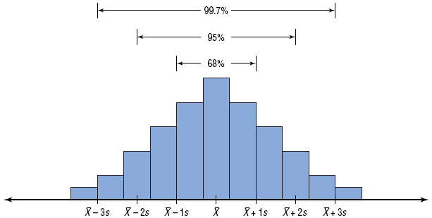
Empirical Rule (Normal)

Slide 69
Example: Travel Allowances
A survey of local companies found that the mean amount of travel allowance for executives was $12 per km. The standard deviation was 3. Find the minimum percentage of the data values that will fall between $3 and $21.
Unknown distribution.
Approximate normal distribution.

Slide 70
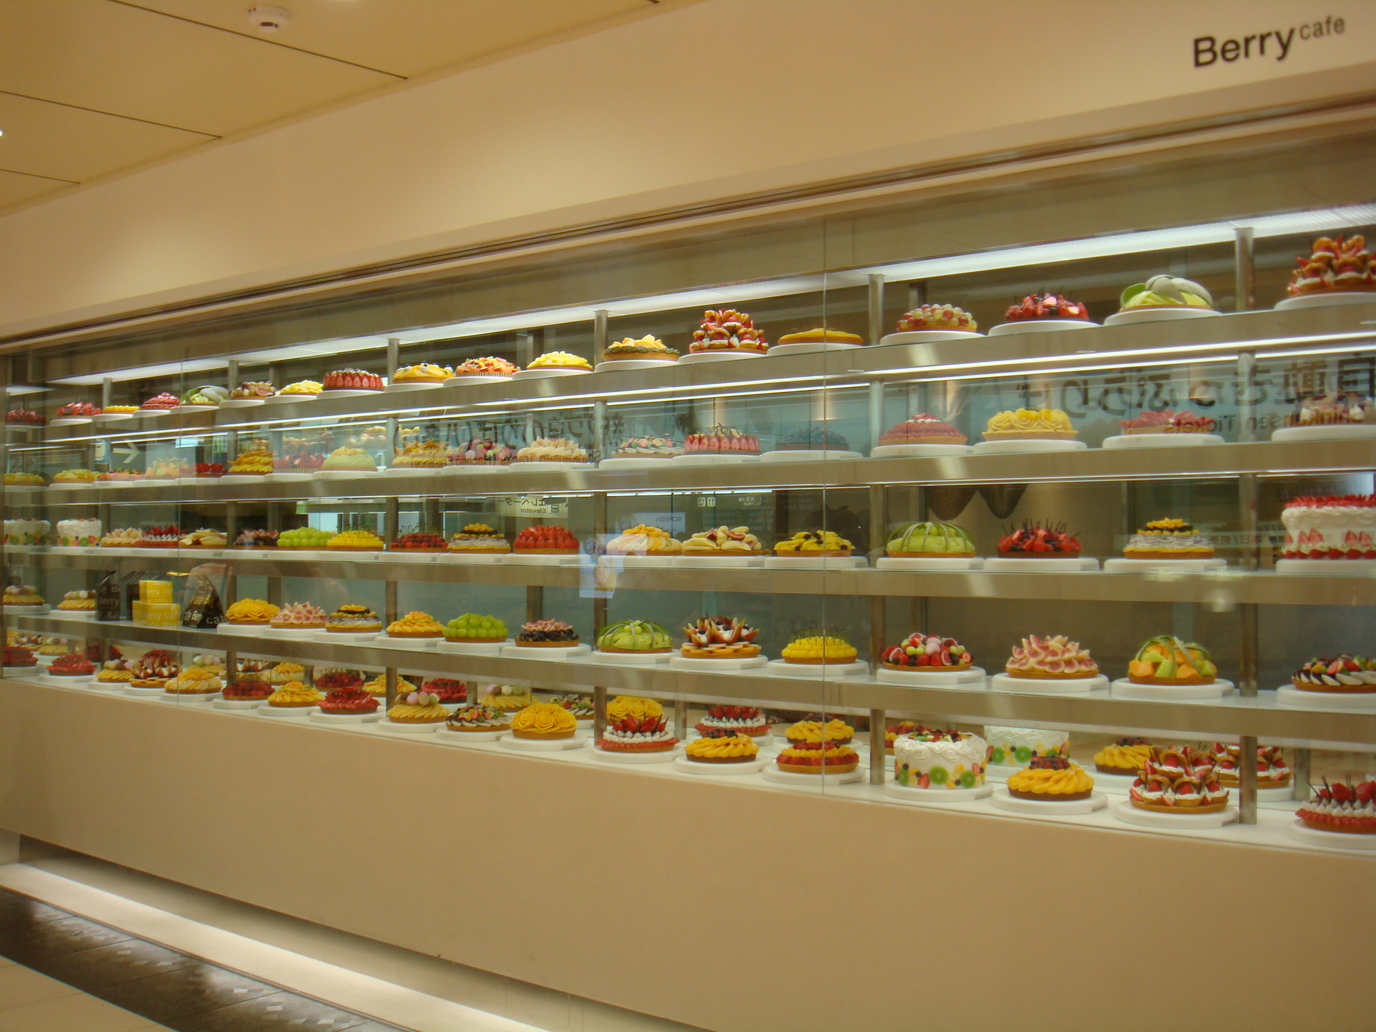

Slide 71
Example: Prices of Homes
The mean price of birthday cakes is $700, and the standard deviation is $150. Find the percentage of price range is between 400 and 1000.
Chebyshev’s Theorem or Empirical Rule?

Slide 72
Section 3-3
Measures of Position

Slide 73
3-3 Measures of Position
Z-score
Percentile
Quartile
Outlier

Slide 74
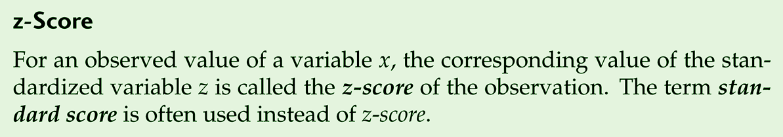
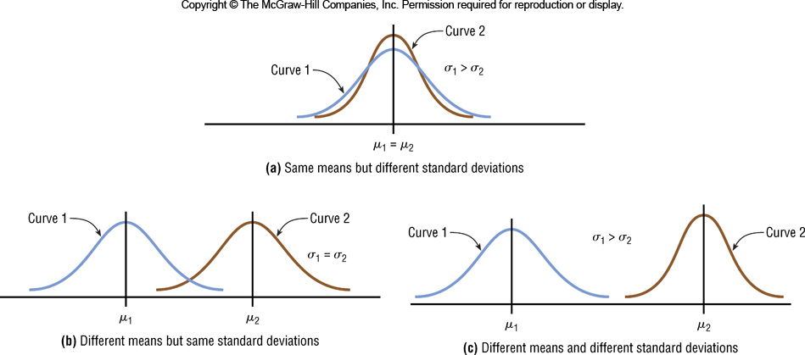
Definition: Z-score

Slide 75
Measures of Position: Z-score
A z-score or standard score for a value is obtained by subtracting the mean from the value and dividing the result by the standard deviation.
A z-score represents the number of standard deviations a value is above or below the mean.

Slide 76
Example 3-28: Test Scores
A student scored 65 on a calculus test that had a mean of 50 and a standard deviation of 10; she scored 30 on a history test with a mean of 25 and a standard deviation of 5. Compare her relative positions on the two tests.
She has a higher relative position in the Calculus class.

Slide 77
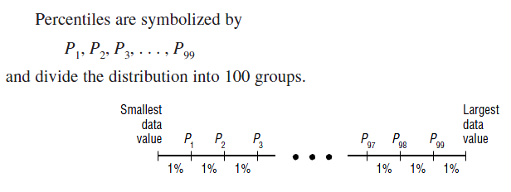
Measures of Position: Percentiles
Percentiles separate the data set into 100 equal groups.
A percentile rank for a datum represents the percentage of data values below the datum.

Slide 78
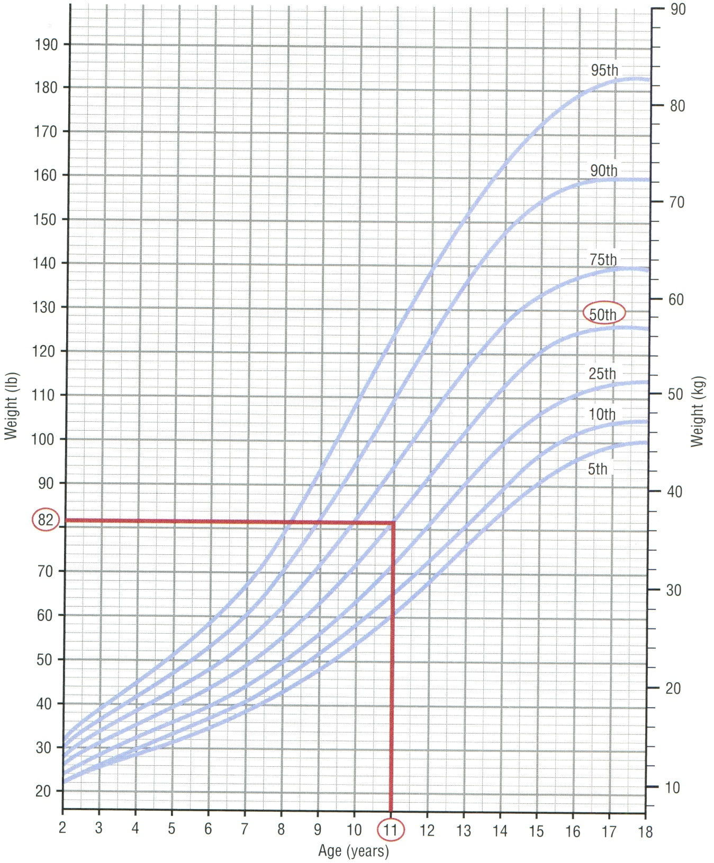
1 lb= 0.454 kg

Slide 79
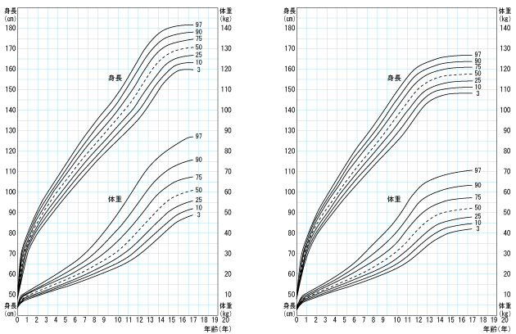

Slide 80
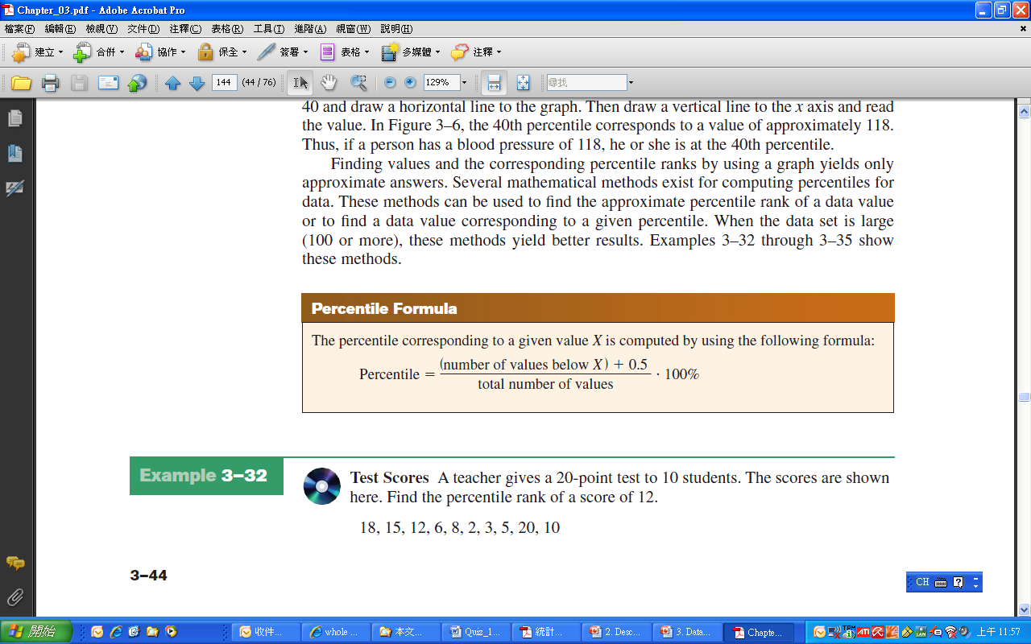
Measures of Position: Percentiles

Slide 81
Example 3-30: Test Scores
A teacher gives a 20-point test to 10 students. Find the percentile rank of a score of 6.
18, 15, 12, 6, 8, 2, 3, 5, 20, 10
Sort in ascending order.
2, 3, 5, 6, 8, 10, 12, 15, 18, 20
3 values
A student whose score was 6 did better than 35% of the class.

Slide 82
Example 3-31: Test Scores
A teacher gives a 20-point test to 10 students. Find the percentile rank of a score of 12.
18, 15, 12, 6, 8, 2, 3, 5, 20, 10
Sort in ascending order.
2, 3, 5, 6, 8, 10, 12, 15, 18, 20
6 values
A student whose score was 12 did better than 65% of the class.

Slide 83
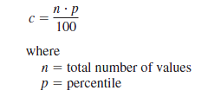
Measures of Position: Percentiles
Find the value c corresponding to the p^{th} percentile.

Slide 84
Example 3-32: Test Scores
A teacher gives a 20-point test to 10 students. Find the value corresponding to the 25th percentile.
18, 15, 12, 6, 8, 2, 3, 5, 20, 10
Sort in ascending order.
2, 3, 5, 6, 8, 10, 12, 15, 18, 20
The value 5 corresponds to the 25th percentile.

Slide 85
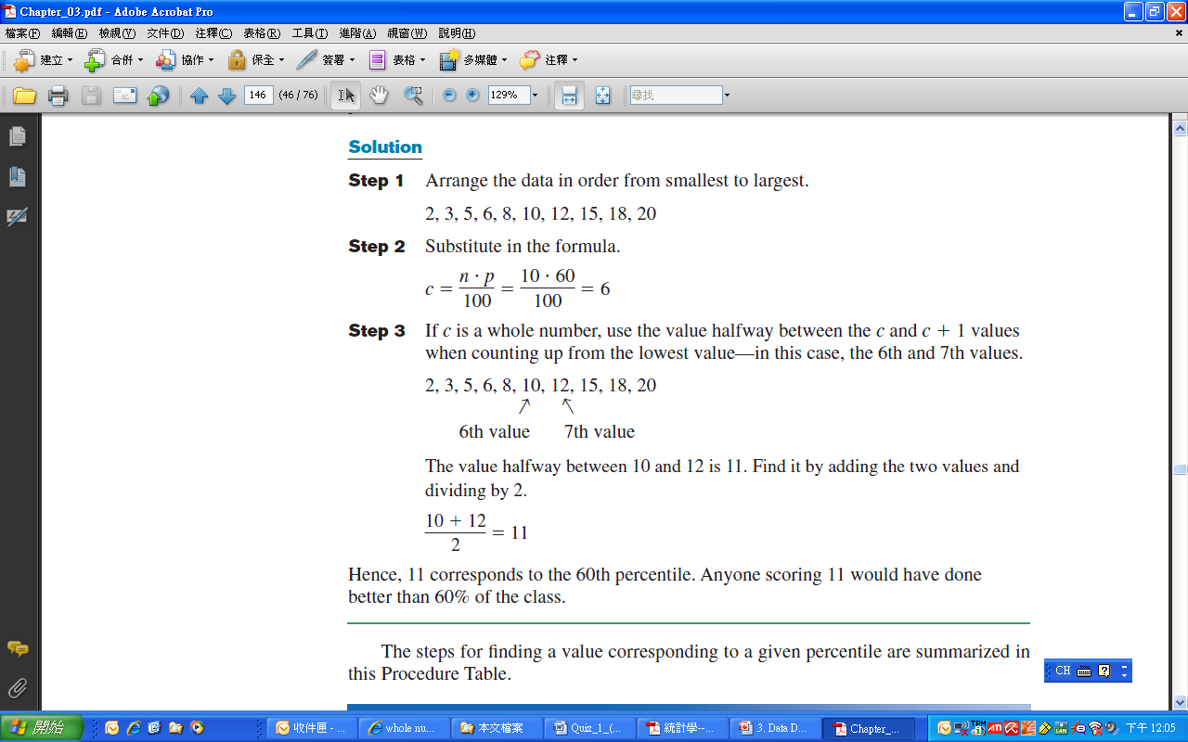
Example 3-33: Test Scores
A teacher gives a 20-point test to 10 students. Find the value corresponding to the 60th percentile.
18, 15, 12, 6, 8, 2, 3, 5, 20, 10
➔Sort in ascending order.
2, 3, 5, 6, 8, 10, 12, 15, 18, 20
The value 11 corresponds to the 60th percentile.

Slide 86
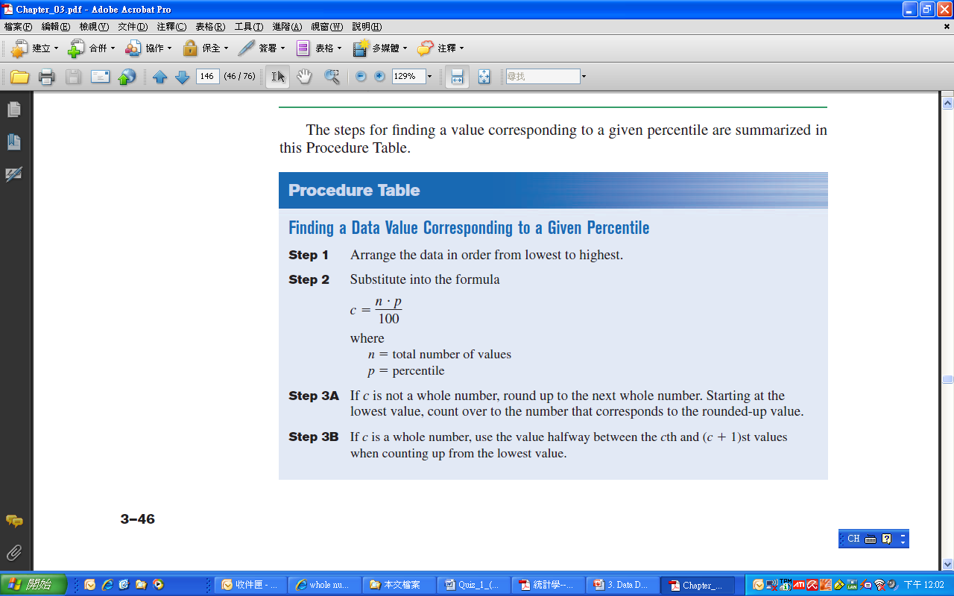

Slide 87
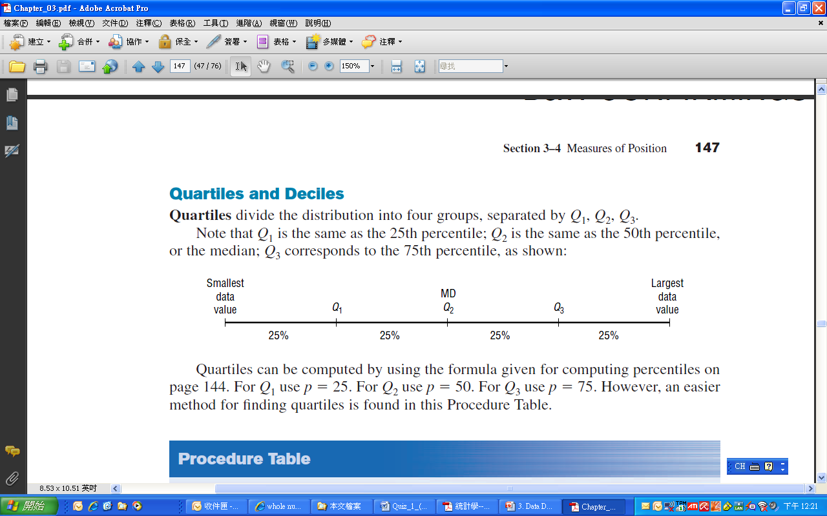
Measures of Position: Quartiles

Slide 88
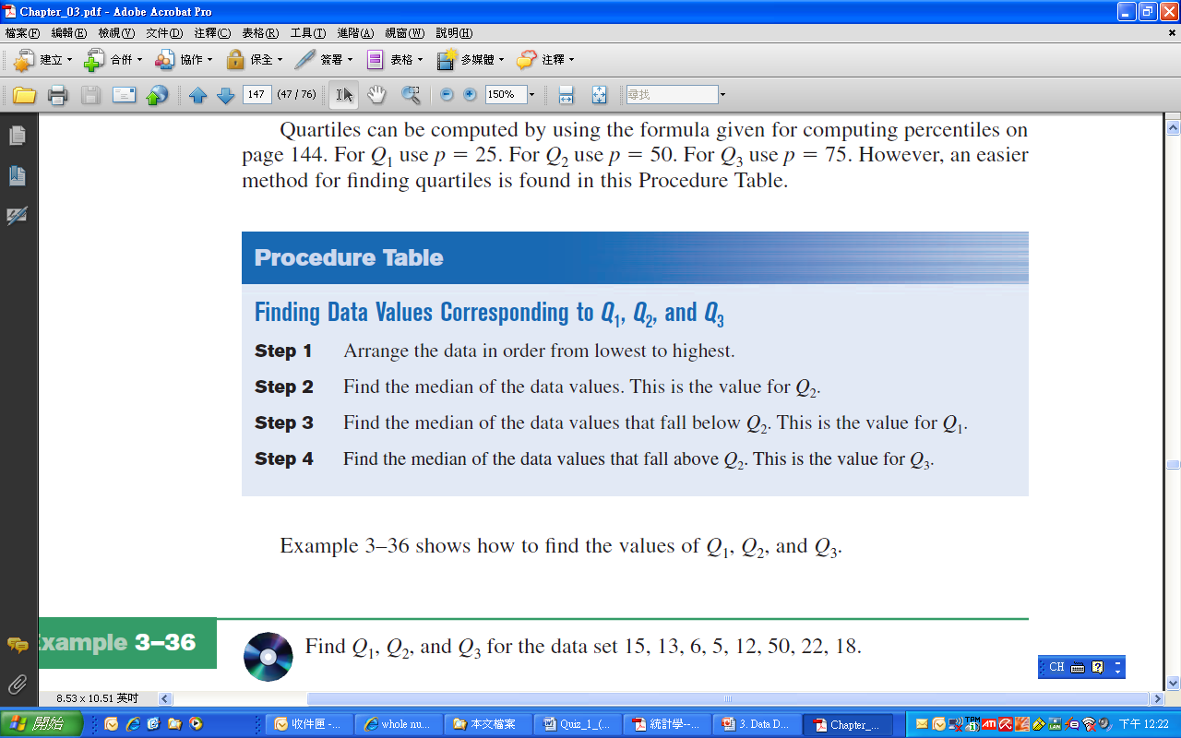

Slide 89
Example 3-34: Quartiles
Find Q₁, Q₂, and Q₃ for the data set.
15, 13, 6, 5, 12, 50, 22, 18
Sort in ascending order.
5, 6, 12, 13, 15, 18, 22, 50

Slide 90
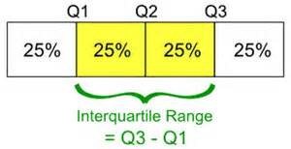
Interquartile Range (IQR)
The interquartile range (IQR) is defined as the difference between Q1 and Q3 and is the range of the middle 50% of the data.

Slide 91
Example 3-35
Find the interquartile for the data set.
15, 13, 6, 5, 12, 50, 22, 18

Slide 92
Quartiles and Deciles
Deciles separate the data set into 10 equal groups. D₁=P₁₀, D₄=P₄₀
Quartiles separate the data set into 4 equal groups. Q₁=P₂₅, Q₂=MD, Q₃=P₇₅
Q₂ = median(Low,High)
Q₁ = median(Low,Q₂)
Q₃ = median(Q₂,High)
The Interquartile Range, IQR = Q₃ – Q₁.

Slide 93
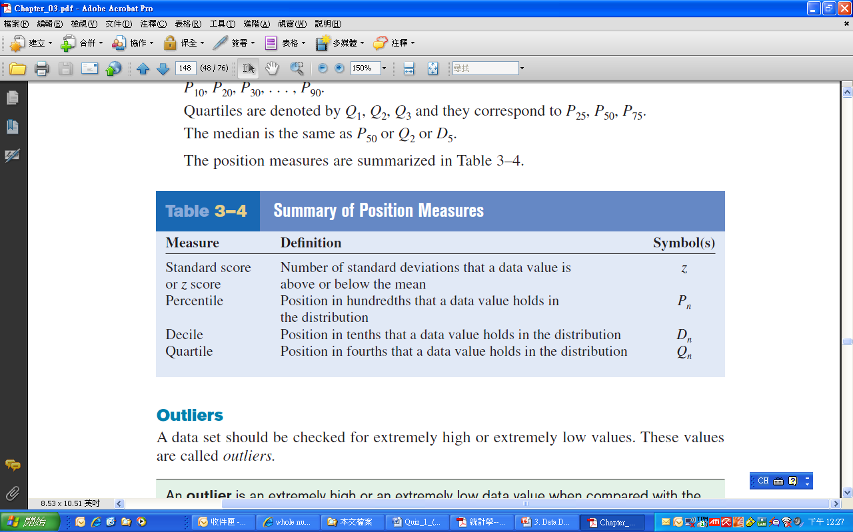

Slide 94
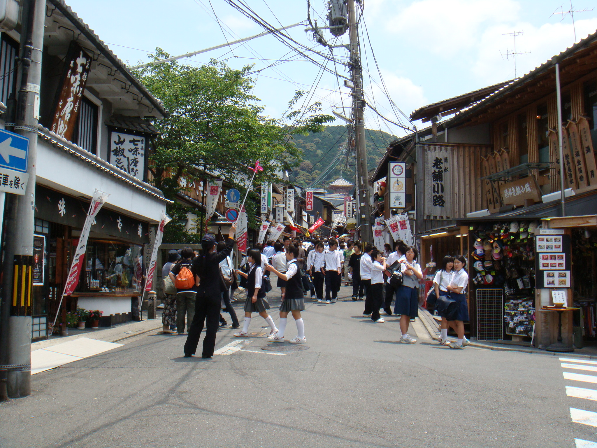

Slide 95
Interquartile Range (IQR)
The interquartile range (IQR) is defined as the difference between Q1 and Q3 and is the range of the middle 50% of the data.
The interquartile range is used to identify outliers, and it is also used as a measure of variability in exploratory data analysis

Slide 96
Measures of Position: Outliers
An outlier is an extremely high or low data value when compared with the rest of the data values.
A data value less than Q₁ – 1.5 (IQR) or greater than Q₁ + 1.5 (IQR) can be considered an outlier.

Slide 97
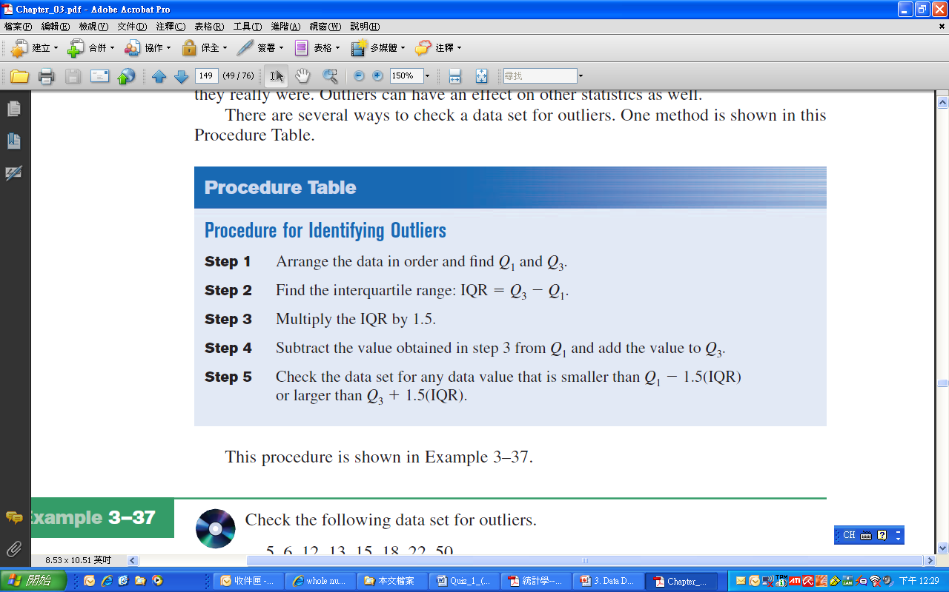

Slide 98
Example 3-36: Outliers
Check the following data set for outliers.
5, 6, 12, 13, 15, 18, 22, 50
➔Q₁ =9 and Q₃ = 20
IQR =Q₃ - Q₁ =20 - 9 =11
1.5* IQR=16.5
Q₁-1.5*IQR= -7.5
Q₃+1.5*IQR=36.5
➔Outlier: 50

Slide 99
Section 3-4
Exploratory Data Analysis

Slide 100
3-4 Exploratory Data Analysis
The Five-Number Summary is composed of the following numbers: Low, Q₁, MD, Q₃, High
The Five-Number Summary can be graphically represented using a Boxplot.
最小值
最大值
Q₁
M_{e}
Q₃

Slide 101
Procedure Table: Constructing Boxplots
Find the five-number summary.
Draw a horizontal axis with a scale that includes the maximum and minimum data values.
Draw a box with vertical sides through Q₁ and Q₃, and draw a vertical line though the median.
Draw a line from the minimum data value to the left side of the box and a line from the maximum data value to the right side of the box.

Slide 102
Example 3-37: Meteorites
The number of meteorites found in 10 U.S. states is shown. Construct a boxplot for the data.
89, 47, 164, 296, 30, 215, 138, 78, 48, 39
30, 39, 47, 48, 78, 89, 138, 164, 215, 296
Five-Number Summary: 30-47-83.5-164-296
Low
Q₁
MD
Q₃
High
47
83.5
164
30
296

Slide 103
Example 3-38

Slide 104
Example: Boxplot with outlier
25 | 41 | 27 | 32 | 43
66 | 35 | 31 | 15 | 5
34 | 26 | 32 | 38 | 16
30 | 38 | 30 | 20 | 21
Q₁ = 23
Q₂ = 30.5
Q₃ = 36.5
Lower limit = 2.75
Upper limit = 56.75
Five-Number: Min, Q1, Q2, Q3, Max
Outlier → Adjusted
5, 15, 16, 20, 21, 25, 26, 27, 30, 30, 31, 32 ,32, 34, 35, 38, 38, 41, 43, 66
Source: Weiss

Slide 105
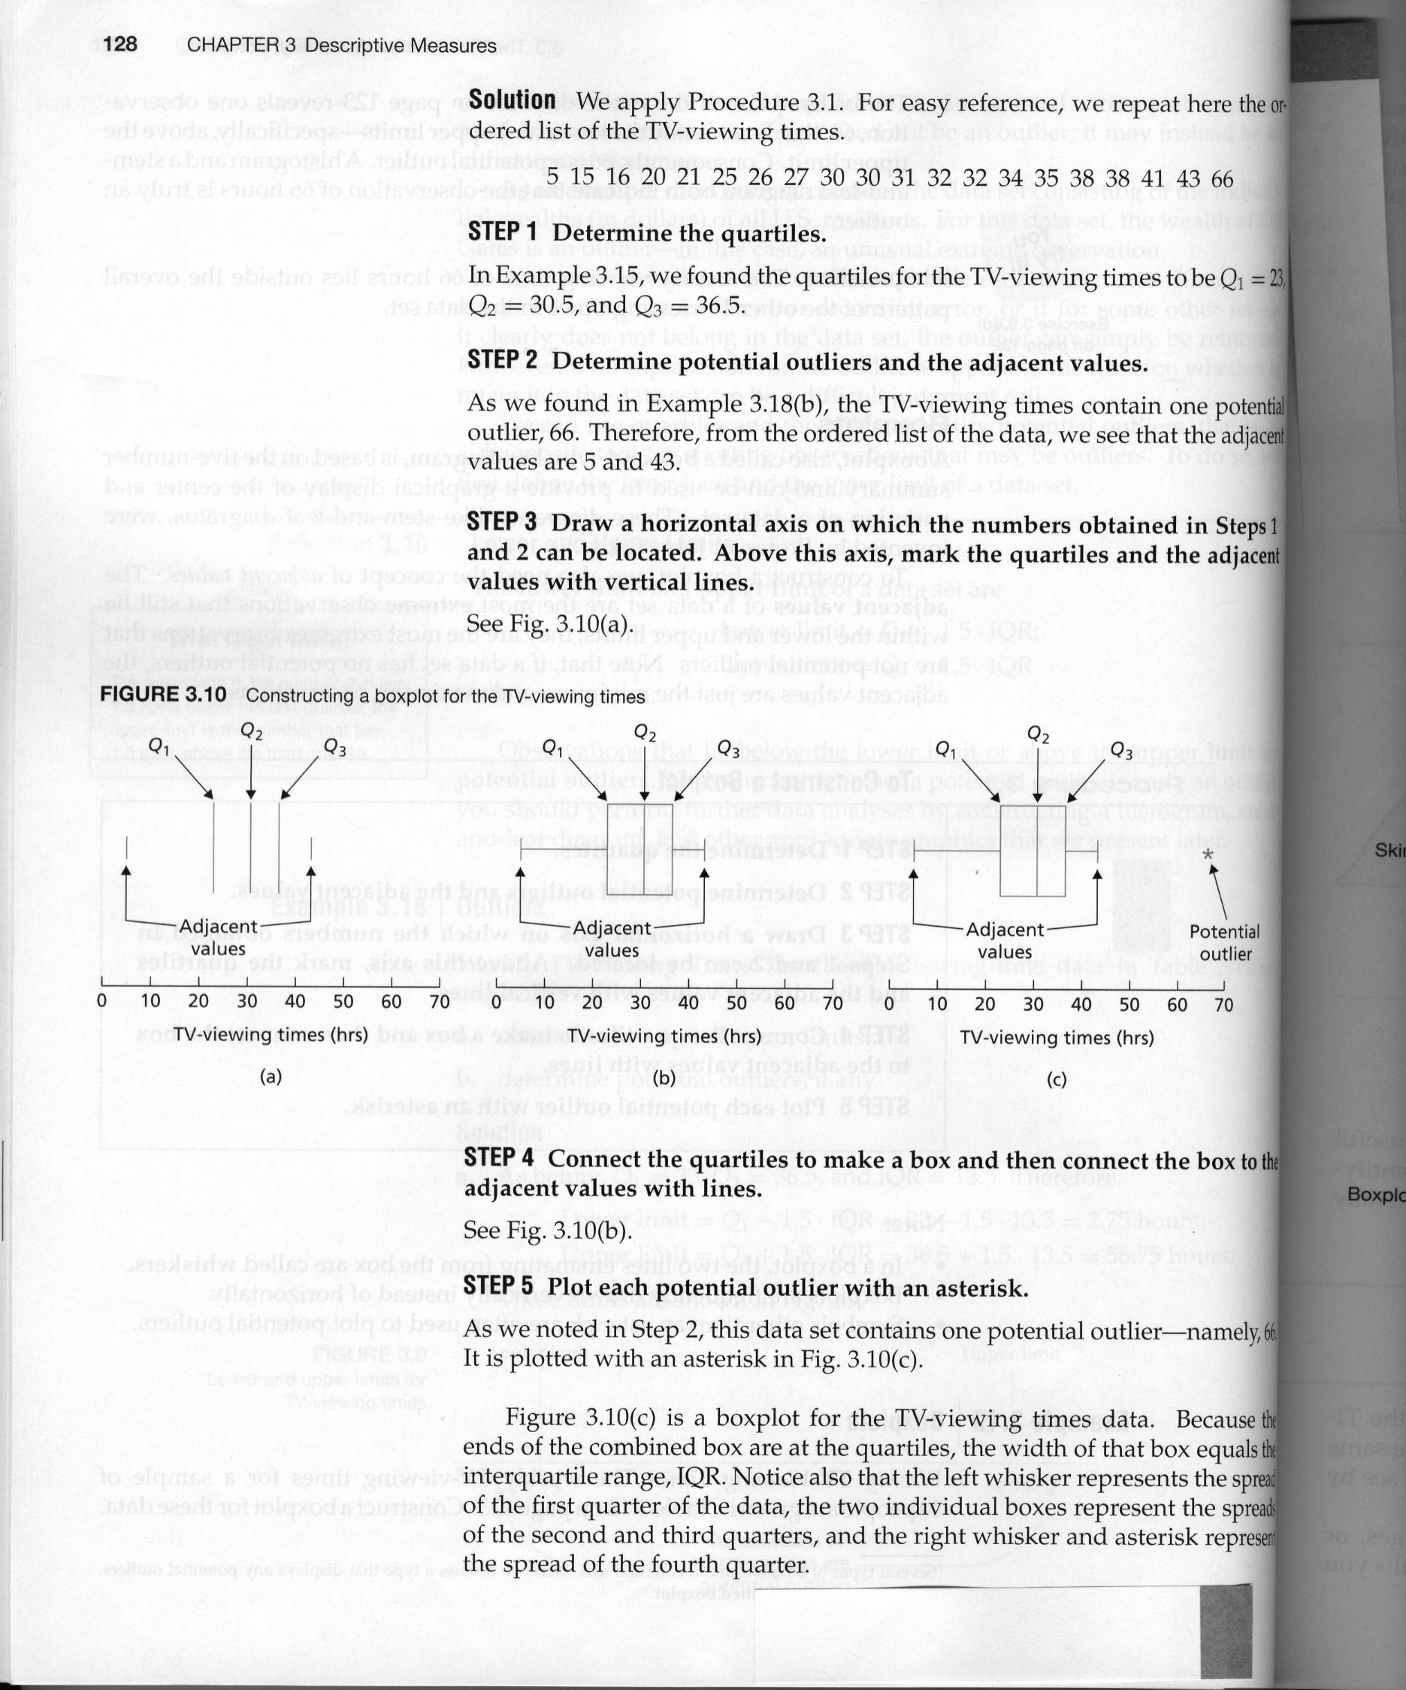
Example: Boxplot with outlier
Source: Weiss

Slide 106
Boxplot & the outlier
外圍
內圍
內圍
外圍
Q₁
中位數
Q₃
平穩界外值
平穩界外值
極端界外值
最小值
最大值
極端界外值
IQR
1.5IQR
1.5IQR
3IQR
3IQR
盒鬚圖與資料的內外圍和界外值

Slide 107
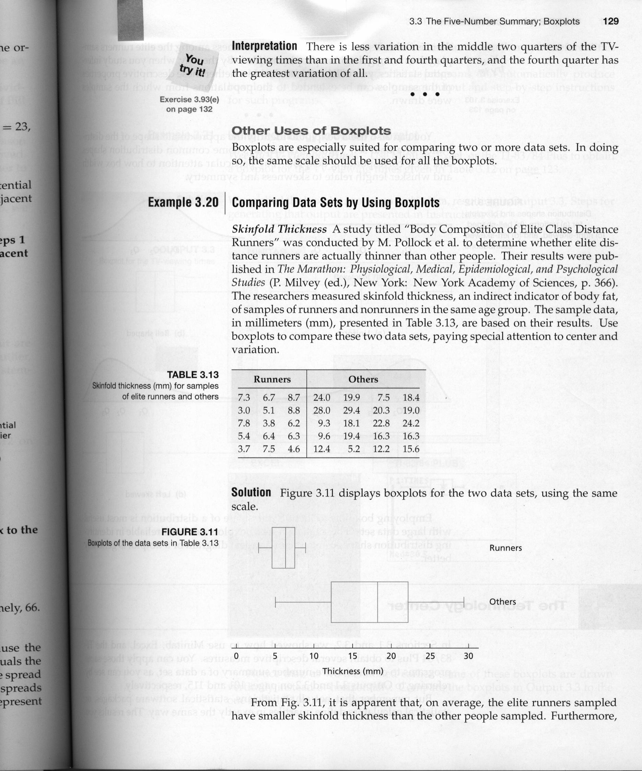
Example: Boxplot
Source: Weiss

Slide 108
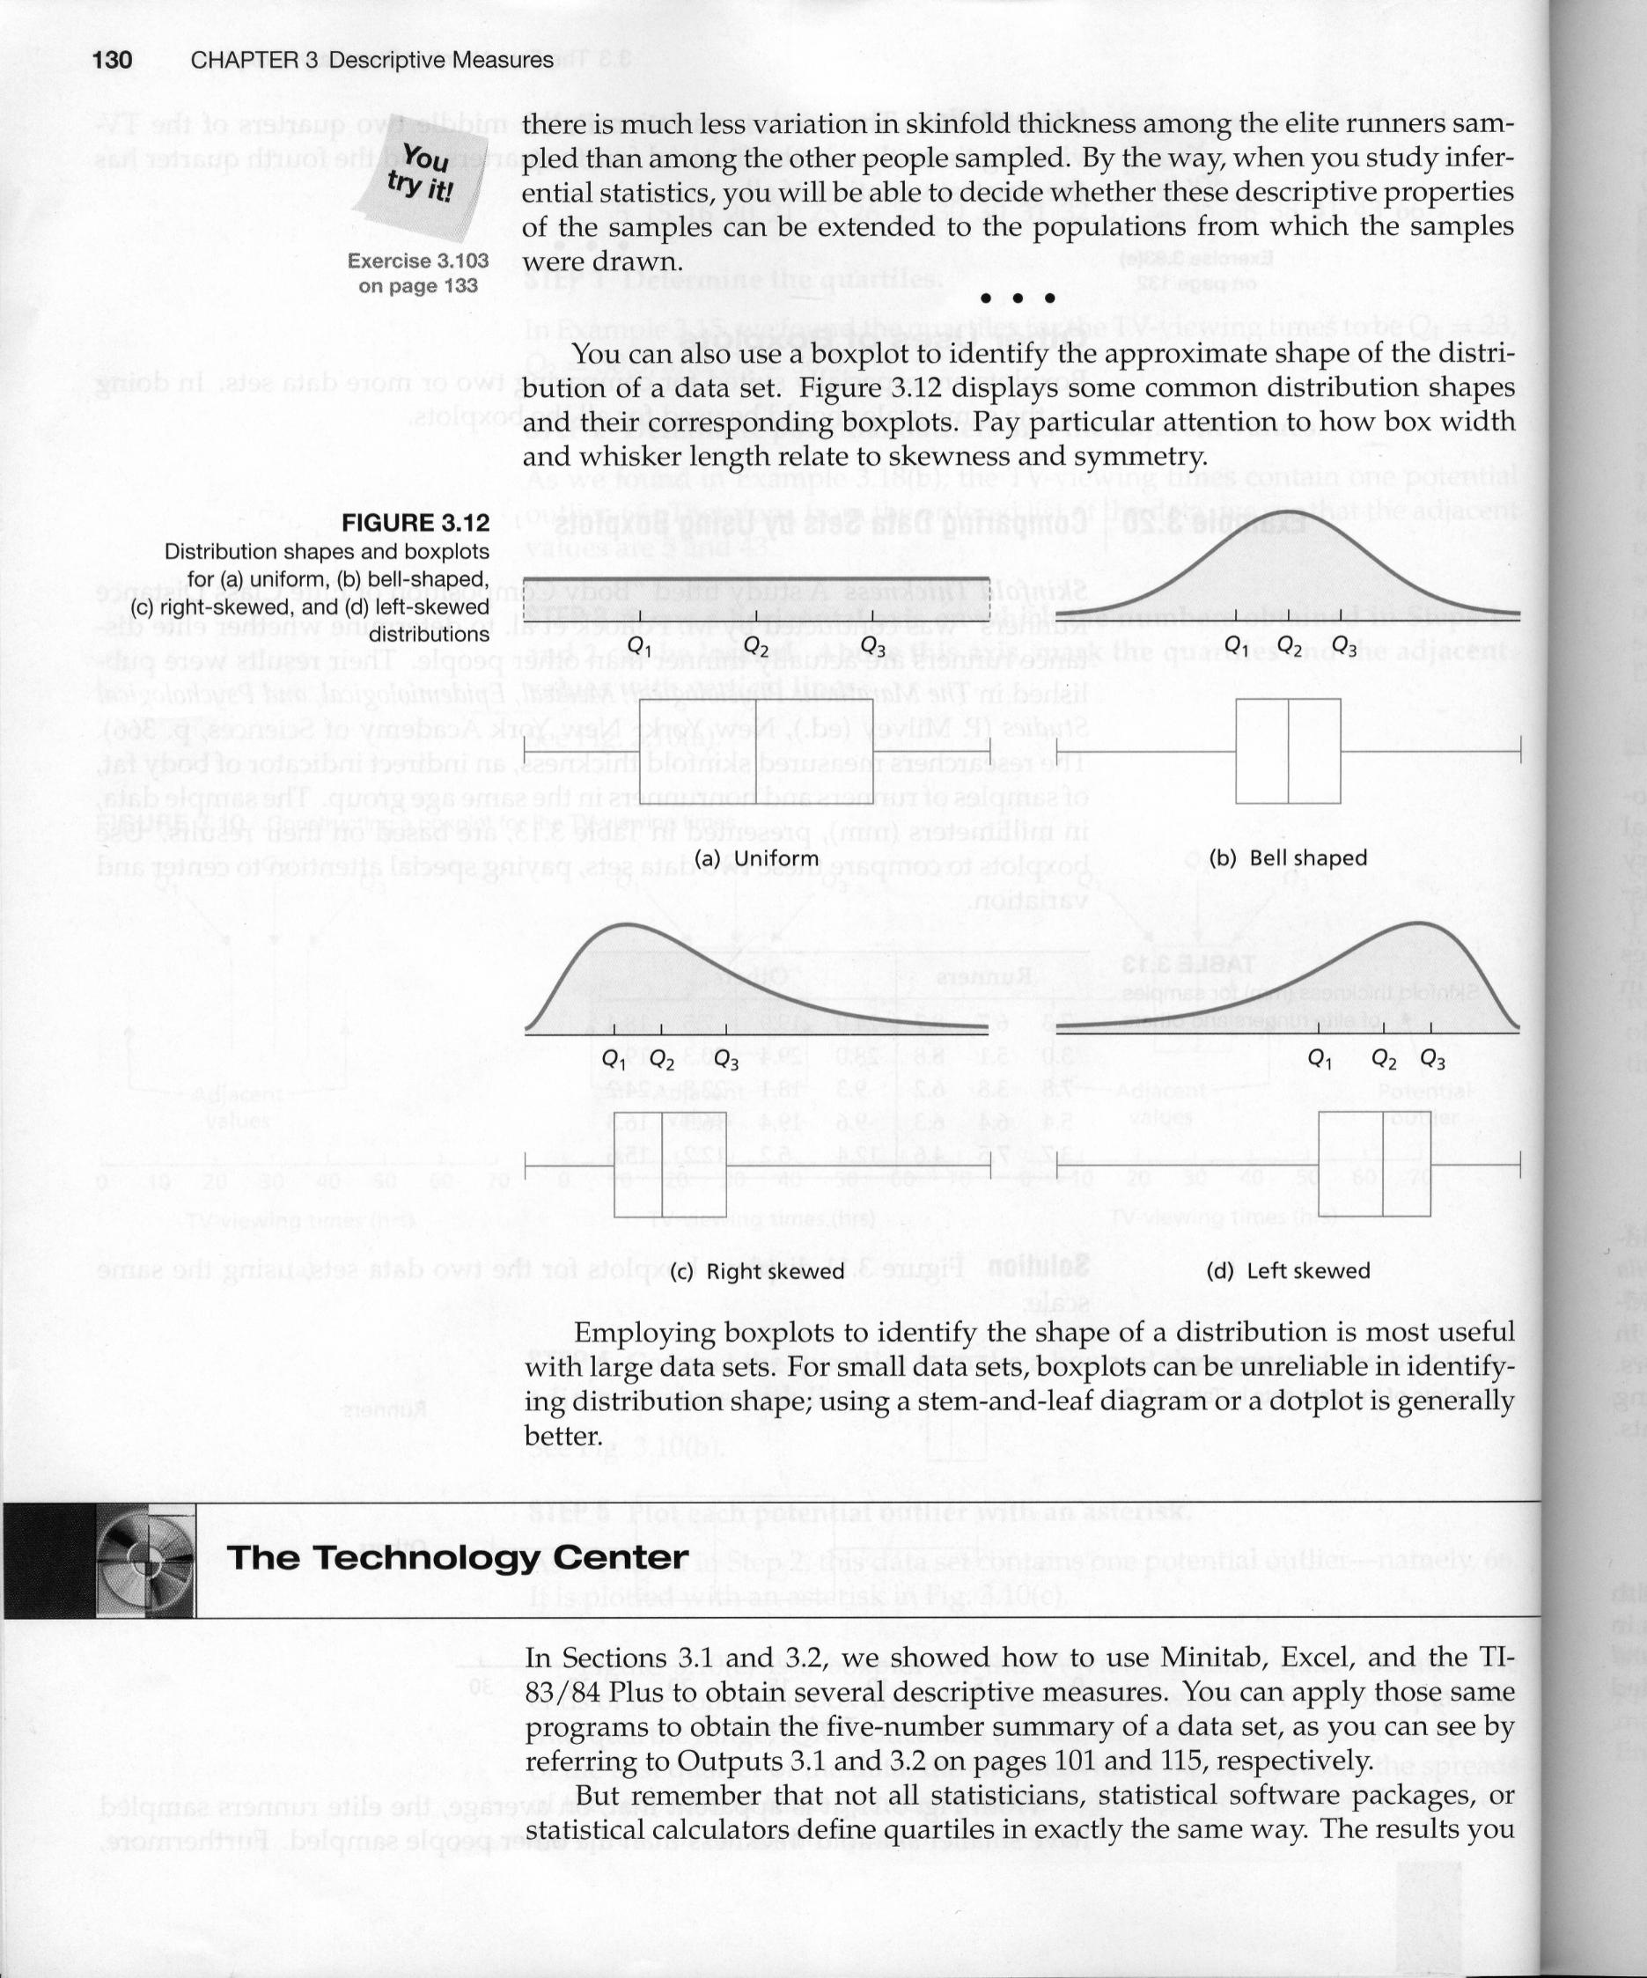
Boxplot & the distribution
Source: Weiss

Slide 109
Exercise
Section 3-1
9,11,13,15,26,27,28,30,34,35
Section 3-2
6,9,30,31,34,40,41,44,46
Section 3-3
10,11,14,16,20,22,27,30,31
Section 3-4
7-11,15,18

